Slide 1
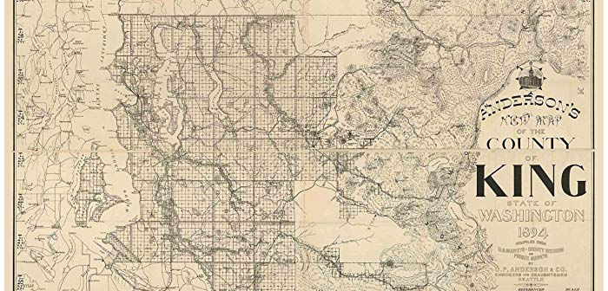
ASSESSMENT OF PRICE DRIVERS IN KING COUNTY

Slide 2

Purpose of the project: to find the best factors, from a large collection of factors, to help us predict the prices of homes in the King County area.
WHY WE’RE HERE

Slide 3
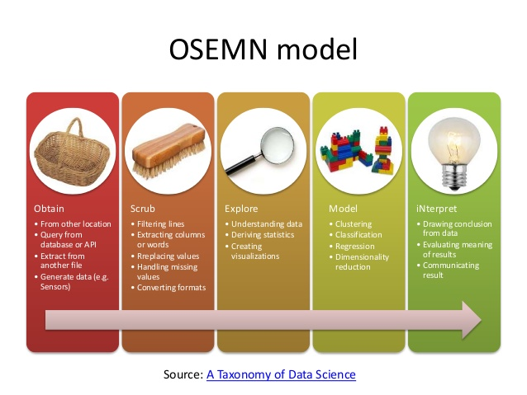
METHODOLOGY

Slide 4


KING COUTY AT A GLANCE
Founded – 1852
Est. Population. – 2,233,163 (2018)
Median Household Income - $78,800
Census Median Home Value
2000 – $235,000
2016 – $407,400

Slide 5
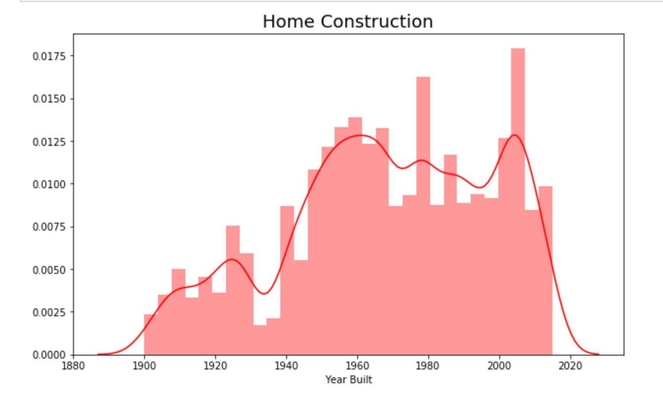
OUR DATA SET AT A GLANCE
Over 20,000 observations—a very healthy sample size
Median Home Value: $450,000

Slide 6
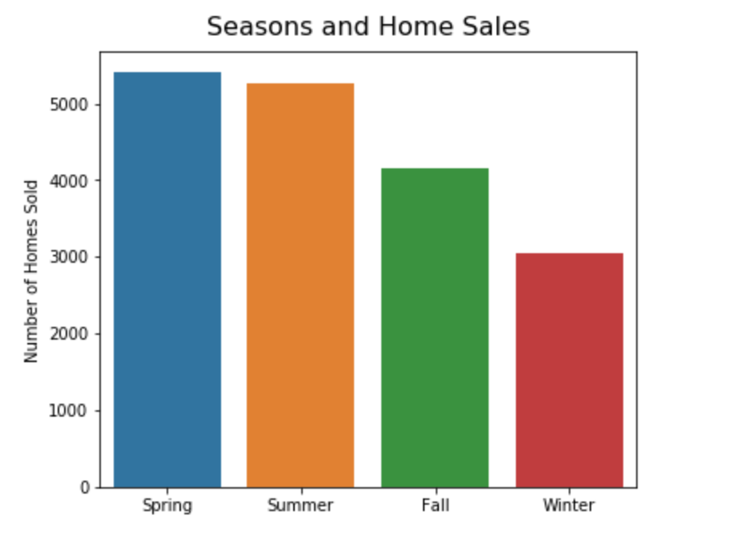
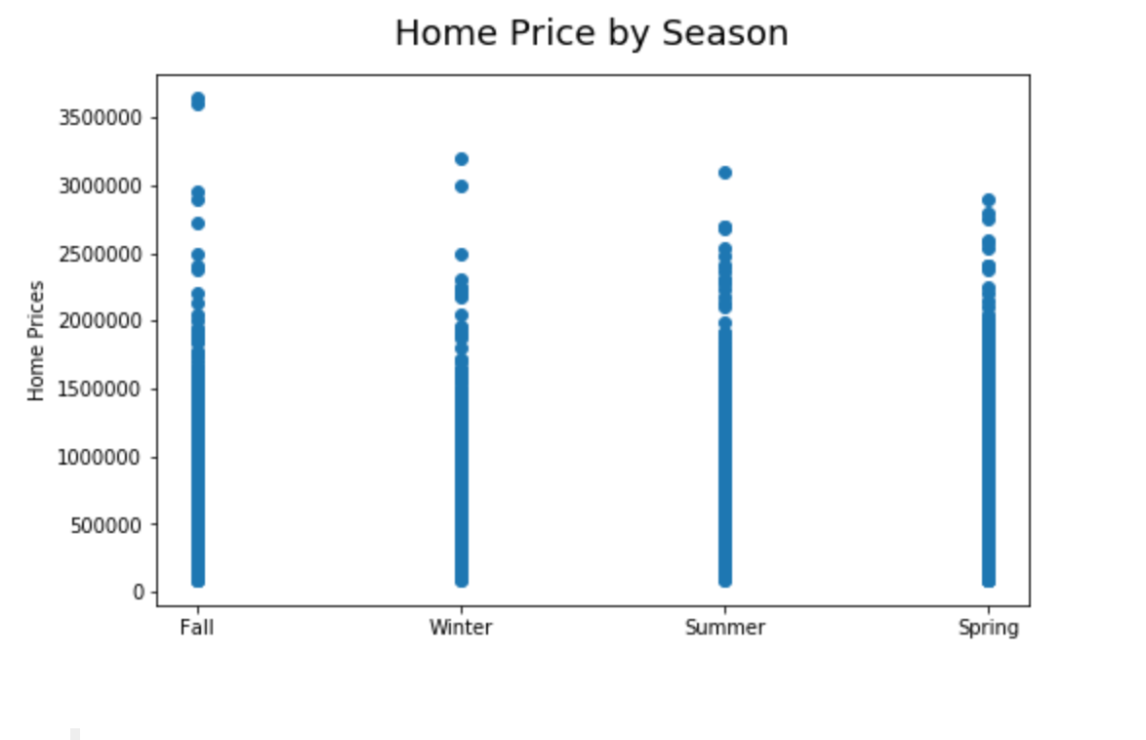
A NOTE ON SEASONS

Slide 7

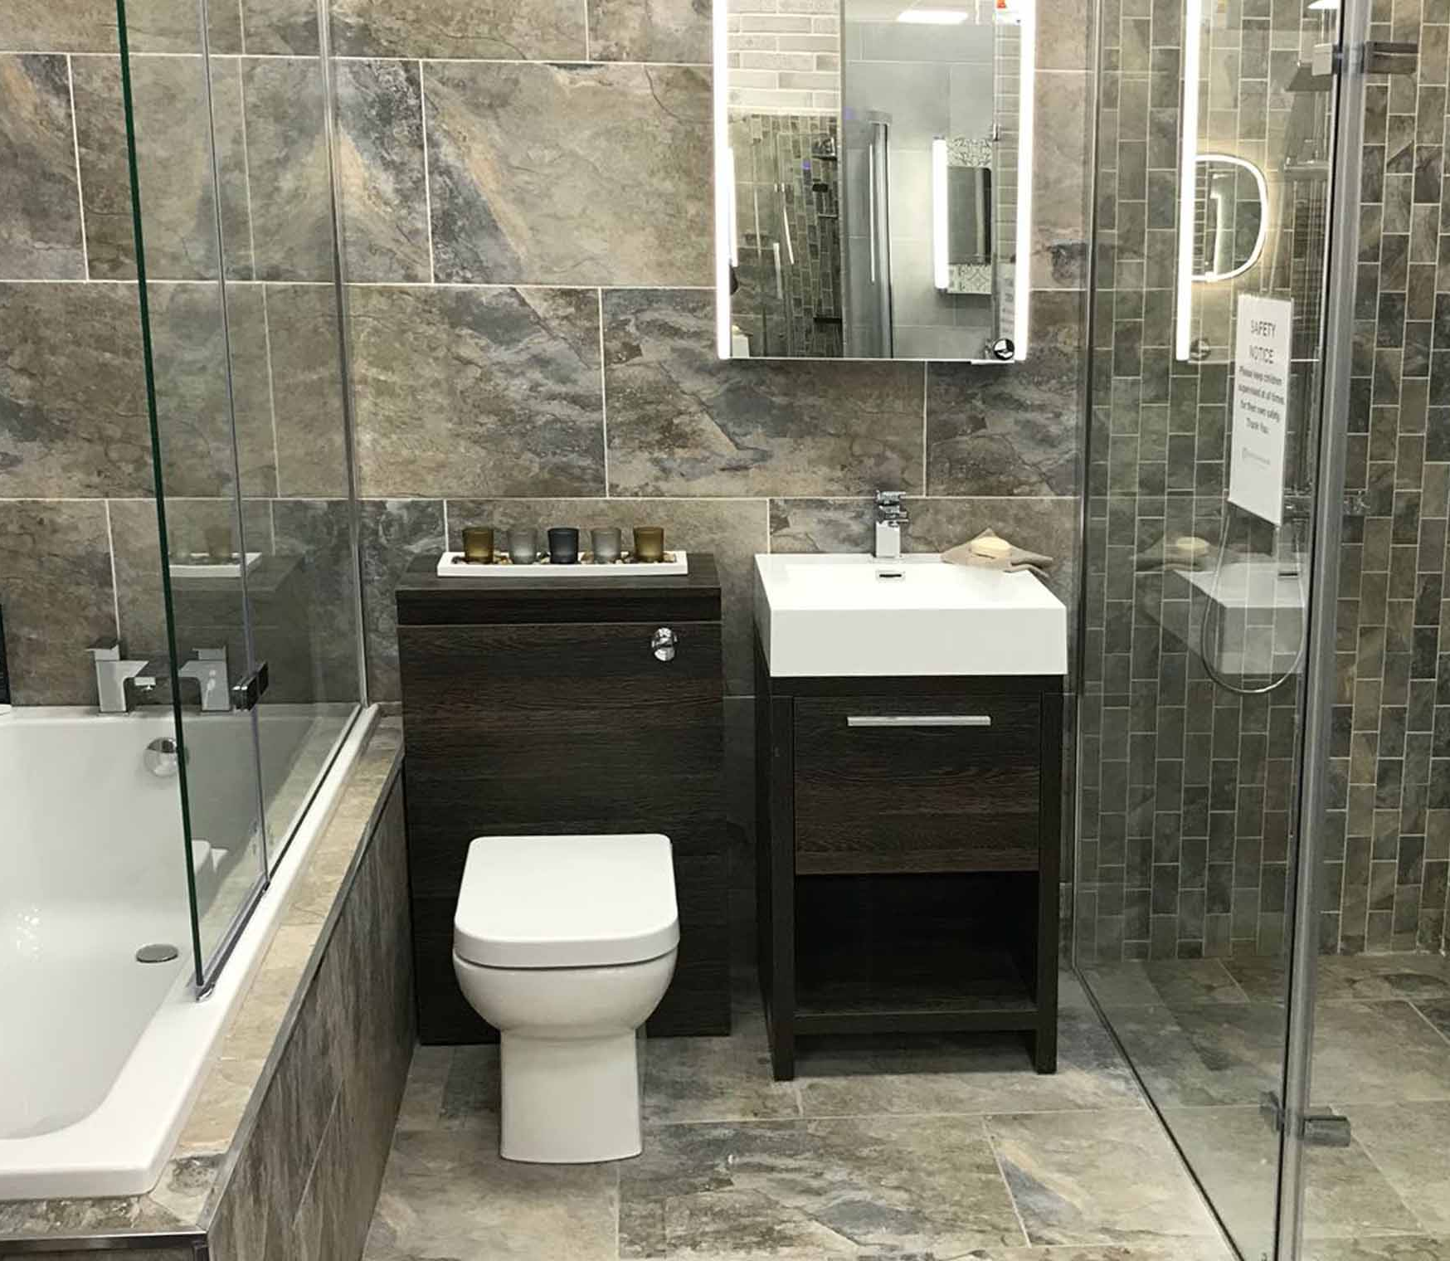

RESULTS — FEATURES
Most Significant Features:
Grade
Bathrooms
Square Footage

Slide 8
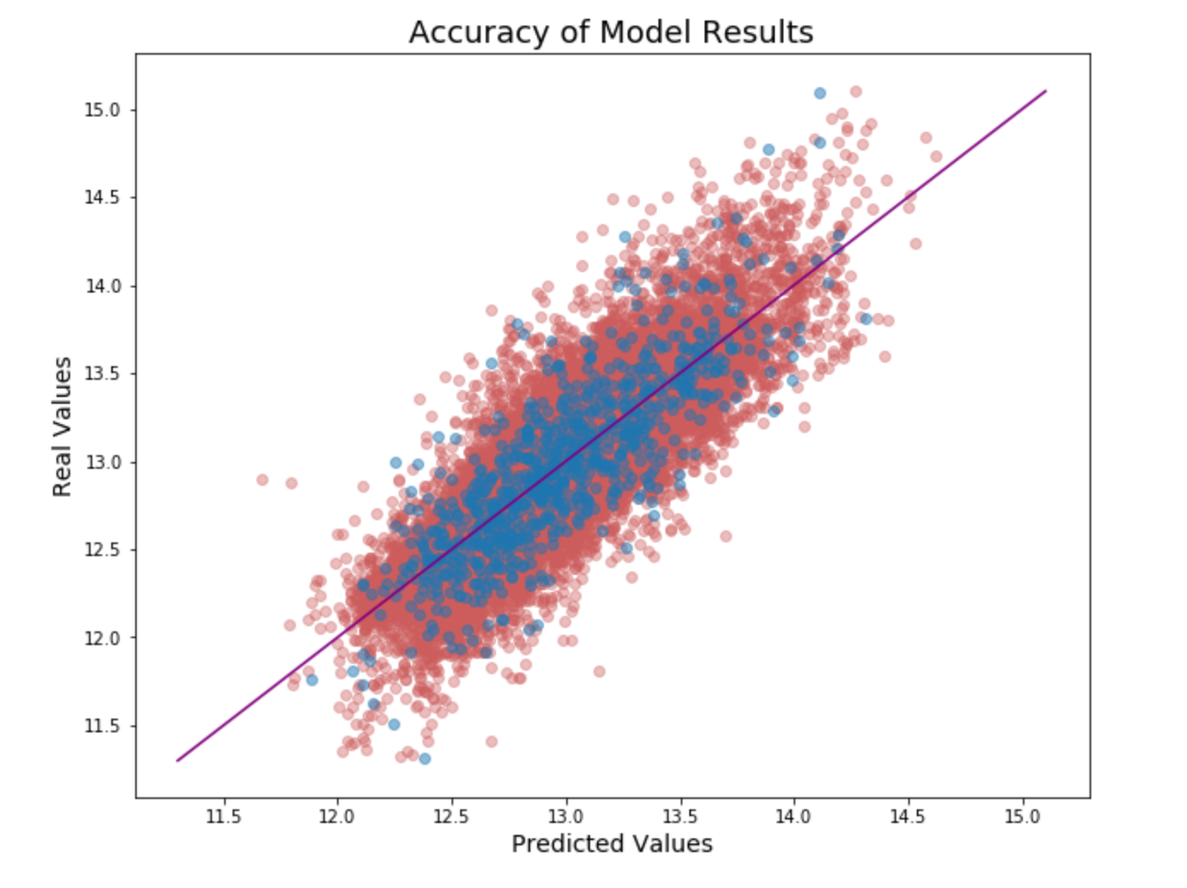
RESULTS — ACCURACY
The closer to a 45 degree angle they are, the better.

Slide 9
THANK YOU!
Questions?
Comments?
Parker Lumkes, data scientist in-training
plumkes@gmail.com

